Slide 1
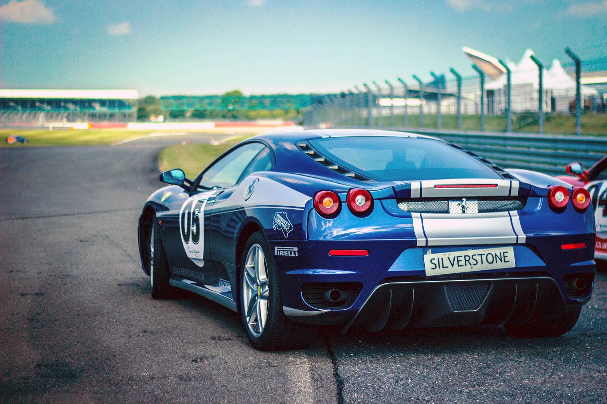





Basic Number Plate Detection on Images of Cars
Basic Number Plate Detection on Images of Cars
OLUSEGUN TIMILEHIN
RAINigeria

Slide 2

Presentation Highlights
Problem Statement
Aim and Objectives
Methodology
Result of Completed Objectives
Conclusion
. . .

Slide 3




AIM
The aim is to design an efficient License Plate Detection System that also returns texts.
OBJECTIVES
To Develop a system which is able to take in image or video feed input to analyze for the presence of a vehicle and its Number Plate.
The system should be able to return the number Plate section from the data feed.
To return the number plate on the image of the Car or to a database.

Slide 4


Problem Statement
The position of vehicle license plate detection in traffic related applications, such as: Traffic offenders, Grand Theft Auto (GTA), ‘hit and run’ can not be over emphasized. Due to variations in the characteristics of license plate from country to country like numbering system, font style and sizes and language of characters, further research is still required in this field.
This current project is the basic and foremost approach towards the broader picture of Vehicle Detection and Recognition (Number Plate, Colour, Type) both for previous data (recordings) and real-time analysis.

Slide 5
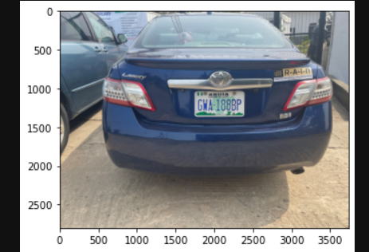
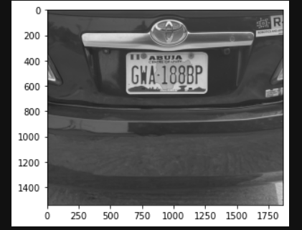
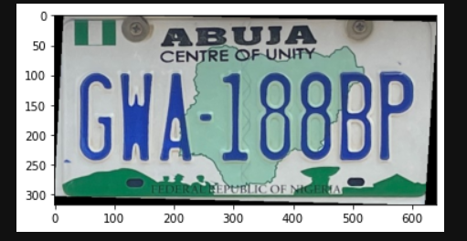

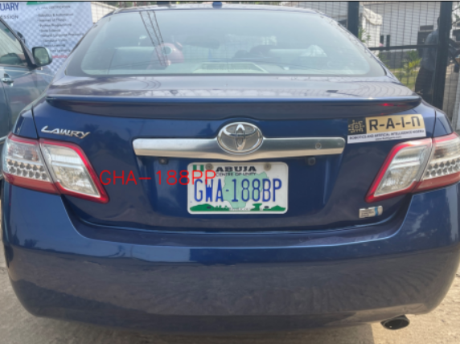
Methodology
Process Info-Graphic Slide
Character Recognition with Easy OCR
Image Feed
Preprocessing
Plate Detection
Number Plate Extraction

Slide 6

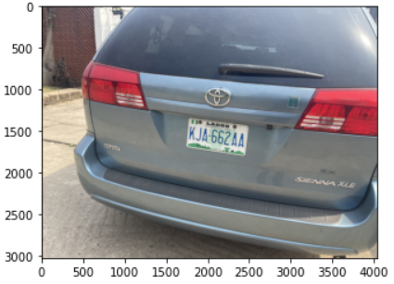
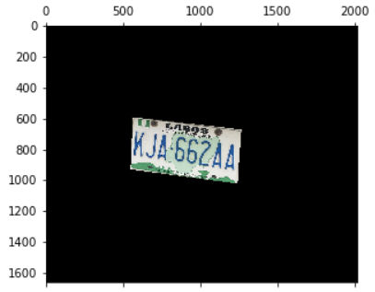
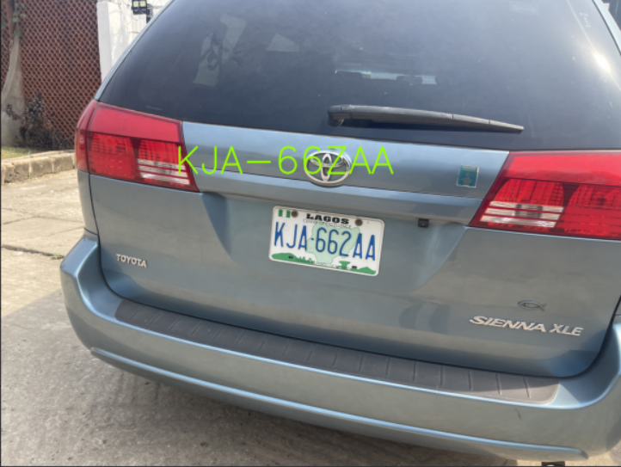

Result of Completed Objectives

Slide 7

Conclusion Recommendations
In this project, a basic number plate detection system was developed. This system currently reads an image, extracts the number plate section and returns the texts on the initial image.
The system has currently been tested and effective on cars images taken at proximities between 1-3 metres.
01
Retraining EASY OCR to better recognize the Characters of Nigerian Plate Numbers.
02
Use of Convolutional Neueral Networks which is most commonly applied in analyzing visual feeds.
03
Applying the system on Video feed, moving objects.

Slide 8



This Presentation is Prepared by
Olusegun Timilehin
One Innovation at a time.

